Slide 1
Telecom Customer Churn Prediction
Team Members
Jamleck Mathenge
Sophia Mbataru
Collins Kiptoo
Bonface Mutua
Getrude Obwoge

Slide 2
Overview
Predicting customer churn is critical for telecommunication companies to be able to retain customers effectively.
For this reason, large telecommunications corporations are seeking to develop models to predict which customers are more likely to change and take action accordingly.

Slide 3
Problem Statement
The telecommunications industry experiences an average of 15-25% annual churn rate.
Given the fact that it costs about 25 times more to acquire a new customer than to retain an existing one, customer retention has now become even more important than customer acquisition.

Slide 4
General Objective
To obtain a data-driven solution that will allow us to reduce churn rates.
Specific Objectives:
To build machine learning models that will predict how likely a customer will churn by analyzing its features: demographic information, account information, and services information.
To find the best machine learning model for the correct classification of churn/non-churn customers.
To determine which features affect the customer churn rate thereby giving necessary recommendations and next steps.

Slide 5
Target Audience
The target audience for our project is Telecom, a telecommunications company, which want to reduce it’s rate of customer churn.

Slide 6
The Data
Our dataset had 7043 entries and 38 columns. These were used to come up with several classification models in an aim to meet our objectives.
The data had 38 features which can be grouped into demographic, account and service information of the customers.

Slide 7
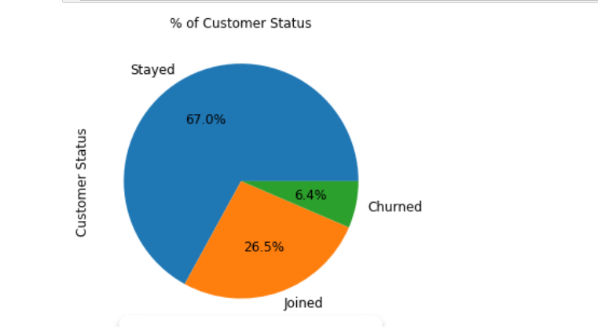
The target Variable

Slide 8
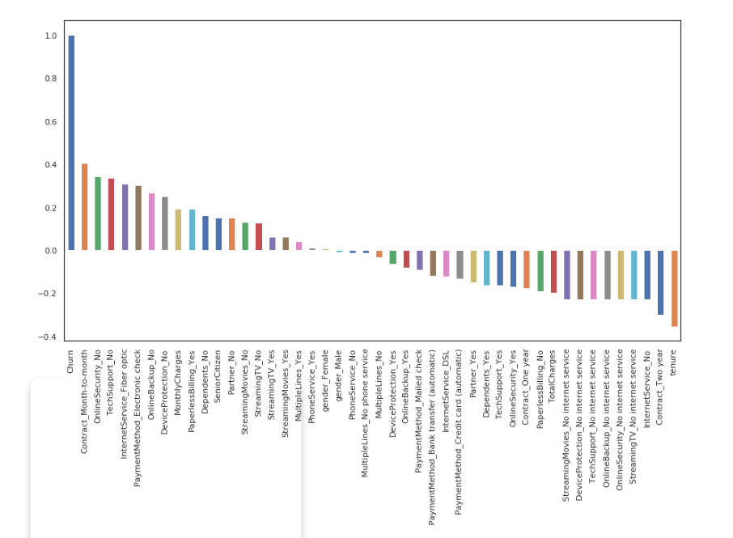
Relationship with the target variable

Slide 9
Conclusion
In conclusion, when customers leave, they are going to the competition. Understanding churn factors will not only allow Telecom to understand why their customers are leaving but also to what extent the factors that lead to customer dissatisfaction affect the company.
Overall, this will lead to the opportunity for Telecom to sharpen its attractiveness in the eyes of its customers by competing in the market well.

Slide 10
Recommendations
Telecom should recruit more customers to their offer packages because there is a clear indication that it reduces customer churning.
Telecom should improve its relationship with new customers because we found out that the highest churning rates occur in the first 10 months.
Telecom should make premium tech support more attractive to customers because customers on the cover have low churn rates.

Slide 11
Recommendations
4. Telecom should make changes to their internet provision services as they all have high churn rates, especially fiber optic internet.
5.Telecom should create products that are attractive to non-senior citizens because non-senior citizens have the highest churn rate
6. Telecom should adopt the Random Forest Classification as it has the highest accuracy of 83%

Slide 12
Next Steps
To further improve the accuracy of this classification, the company should focus on other factors that might affect the churn rate.
These factors include:
Customer Churn Reason
Churn Category

Slide 13

Questions?

Slide 14

Thank You!

